Slide 1


Data Models
ER Model
Asif Sohail
University of the Punjab
Punjab University College of Information Technology (PUCIT)

Slide 2
Outline
Introduction
Basic Constructs and Notations
Connectivity / Cardinality of a Relationship
Degree of a Relationship
Existence Dependency (Identifying Relationship)
Associative Entity
Modeling Multivalued Attribute
Enhanced ER Model

Slide 3
E-R Model
It stands for Entity Relationship Model.
It is a detailed, logical representation of the data for an organization.
It is the mainstream approach for conceptual data modeling.
It is most often used as a communication tool between database designers and end users during analysis phase of database development.
It was proposed by Peter Chen in 1976 for conceptual database design
The model has been subsequently extended in 1986 and 1991.
It expresses logical representation for an organization in terms of Entities, Relationships among Entities and Attributes of Entities and Relationship.
It uses E-R Diagrams.
E-R Diagram is a graphical representation of an E-R Model.
The Basic Constructs of ER Model are:

Slide 4
ER Model – Basic Constructs
Entity
Relationship
Attribute
Multi valued
Associative
Entity
Strong
Strong
Weak
Associative
Entity

Slide 5
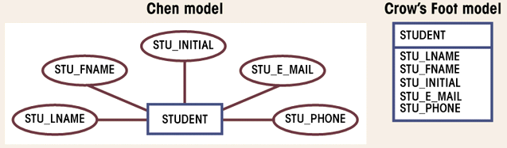
ER Model – Notations
ENTITY NAME
Identifier Attribute [Derived] {Multivalued} Composite( , , )

Slide 6
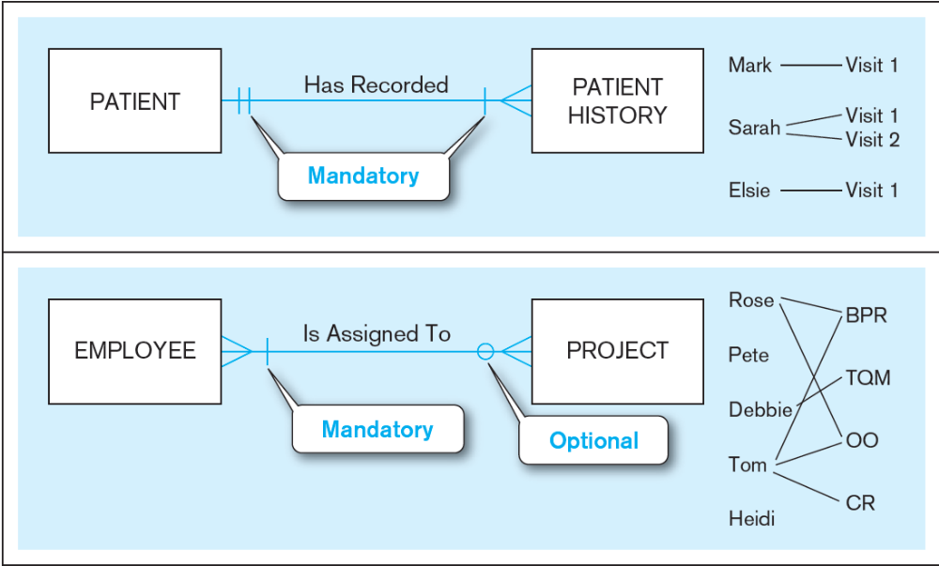

Sample ERD

Slide 7
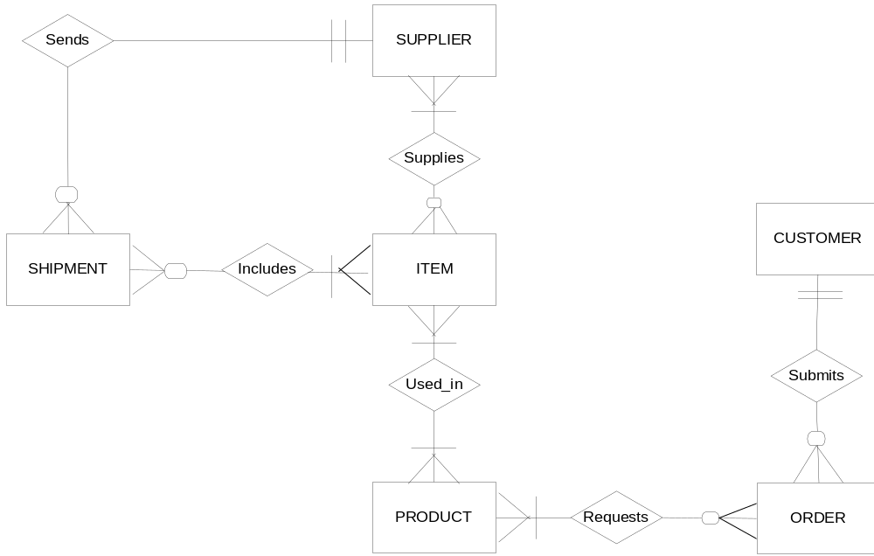
Sample ERD

Slide 8
Naming Entity Type
Use capital letter for names of entity types.
An entity name
  Is a singular noun e.g. CUSTOMER
  Should be specific to the organization e.g. CUSTOMER, CLIENT
  Should be concise, using as few words as possible e.g. REGISTRATION is better than STUDENT REGISTRATION FOR CLASS
  Should be same for all E-R diagrams on which the same entity type appears
An attribute should be descriptive of the data represented by that attribute.
It is a good practice to prefix the entity name (or its abbreviation) with the attribute name. For example, CUST_ADDRESS.

Slide 9
E-R Model
Relationship
A relationship is any association, linkage, or connection between the entities of interest to the business; it is a bi-directional, significant association between entities, or between an entity and itself.
Relationship is a glue that holds the entities together.
Entities enrolled in a relationship are called its participants.
An example of a relationship would be:
  Employees are assigned to projects
  Projects have subtasks
  Departments manage one or more projects
The association (connectivity) between the entity instances can be One to One (1:1), One to Many (1:M) and Many to Many (M:N)
To identify the type of association or connectivity between entity A and entity B, ask yourself the following two questions:
  How many instances of B are related to each instance of A?
  How many instances of A are related to each instance of B?

Slide 10
E-R Model
Cardinality of a Relationship
It refers to the number of entity instances of one entity type that can be associated with the number of entity instances of the other entity or same entity type.
It assigns a specific value to connectivity.
There are two types of cardinality:
a) Minimum Cardinality
b) Maximum Cardinality
Cardinality of relationship is expressed as:
(min-card, max-card)
Min/Max cardinalities refer to the Min/Max number of entity instances of one entity type that can be associated with the number of entity instances of the other entity or same entity type.

Slide 11
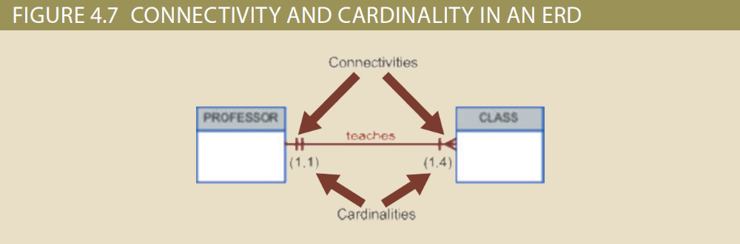
Cardinality of a Relationship

Slide 12
E-R Model
Relationship Participation
Participation of an entity instance in a relationship can be of two types: i) Mandatory Participation (Min Card=1,2,3,… )
ii) Optional Participation (Min Card=0)
The combination of minimum and maximum cardinality gives rise to the following final combinations:
a) Mandatory One Cardinality
(Min Card=1, Max Card=1)
b) Mandatory Many Cardinality
(Min Card=1, Max Card=Many)
c) Optional One Cardinality
(Min Card=0, Max Card=1)
d) Optional Many Cardinality
(Min Card=0, Max Card=Many 1)

Slide 13
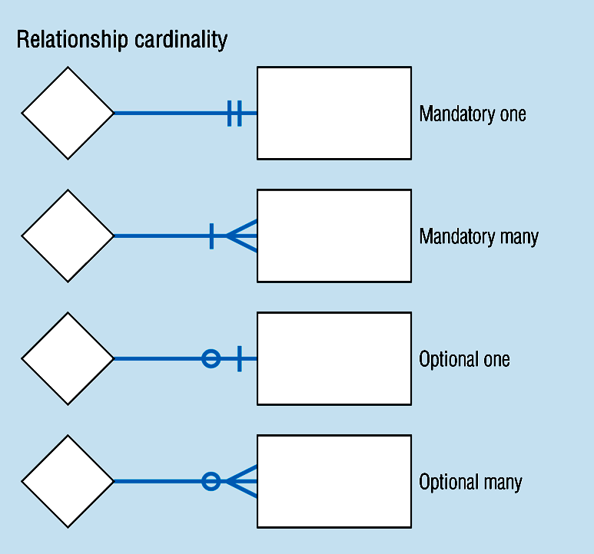
Relationship Participation

Slide 14
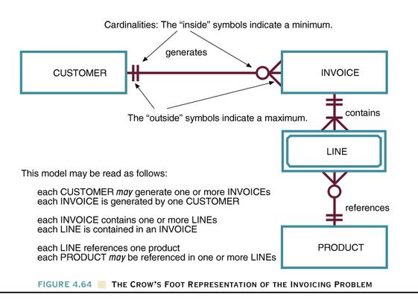
The Crow’s Foot Representation of the Invoicing Problem
Figure 4.64

Slide 15
E-R Model
Roles in Relationships
The way an entity is involved in a relationship is called the role of the entity in the relationship. These details provide more semantics of the database.
The role is generally clear from the relationship, but in some cases it is necessary to mention the role explicitly.
Two situations to mention the role explicitly are:
Recursive Relationship
Multiple Relationships
There exists multiple relationships between the same pair of entities.
Notes:
Page 92 (Hoffer)

Slide 16
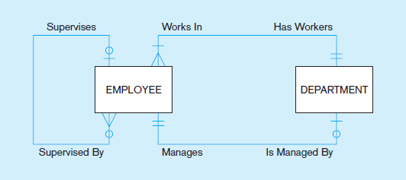
E-R Model
Roles in Relationships
Notes:
Page 92 (Hoffer)

Slide 17
E-R Model
Existence Dependency
An instance of one entity can’t exist without the existence of some other related entity.
An entity having an existence dependency is referred as Weak Entity and it may optionally be represented by double rectangle.
An entity without an existence dependency is referred as Strong Entity or Regular Entity.

Slide 18
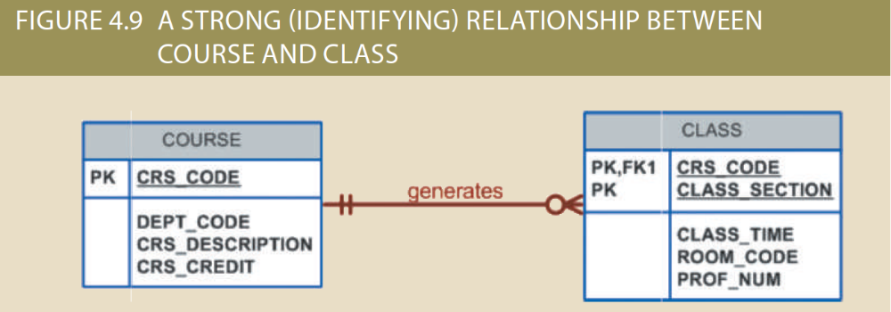
E-R Model
Relationship Strength
a) Strong or Identifying Relationships
Weak entities often don’t have a natural identifier and the PK of the parent entity is used as part of the PK of the weak (child) entity.
It offers the following benefits:
  i) Data Integrity
  ii) Ease of Access of the Dependent Entity

Slide 19
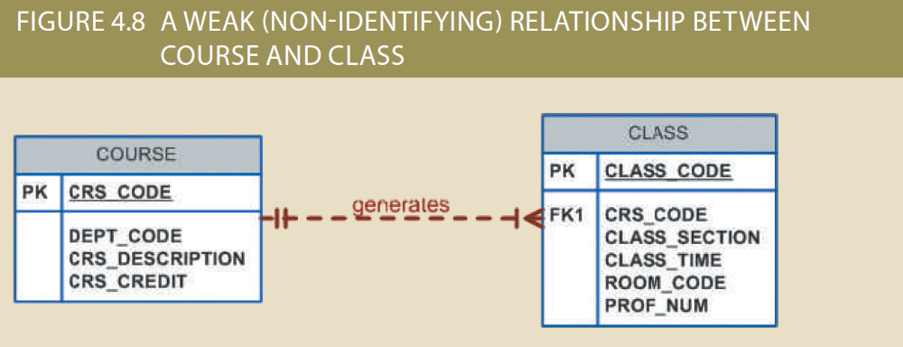
E-R Model
Relationship Strength
b) Weak or Non-Identifying Relationships
It is a relationship between two regular entities, where primary keys of the related entities are disjoint.

Slide 20
Example
Composite attribute
First_Name
Last_Name
Middle_Name
Identifier
Employee_ID
Employee_Name
Dependent_Name
Date_of_Birth
EMPLOYEE
Has
ENTITY
DEPENDENT
Strong entity
Identifying relationship
Weak entity

Slide 21
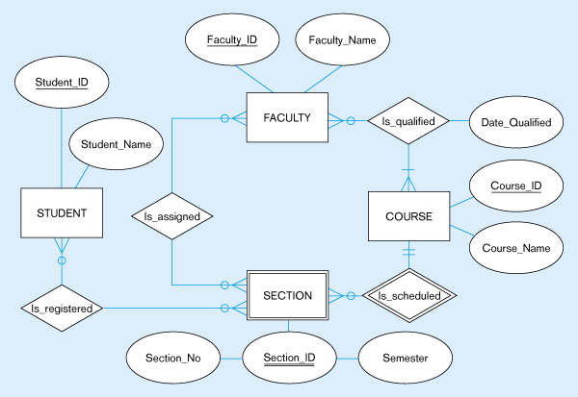
Data model segment for class scheduling

Slide 22
E-R Model
Degree of Relationship
It refers to the number of entities participating in a relationship.
There can be following types of relationships on the basis of degree:
a) Unary Relationship (relationship between the instances of a single entity type)
b) Binary Relationship (---- Two----)
c) Ternary Relationship (---- Three ----)

Slide 23
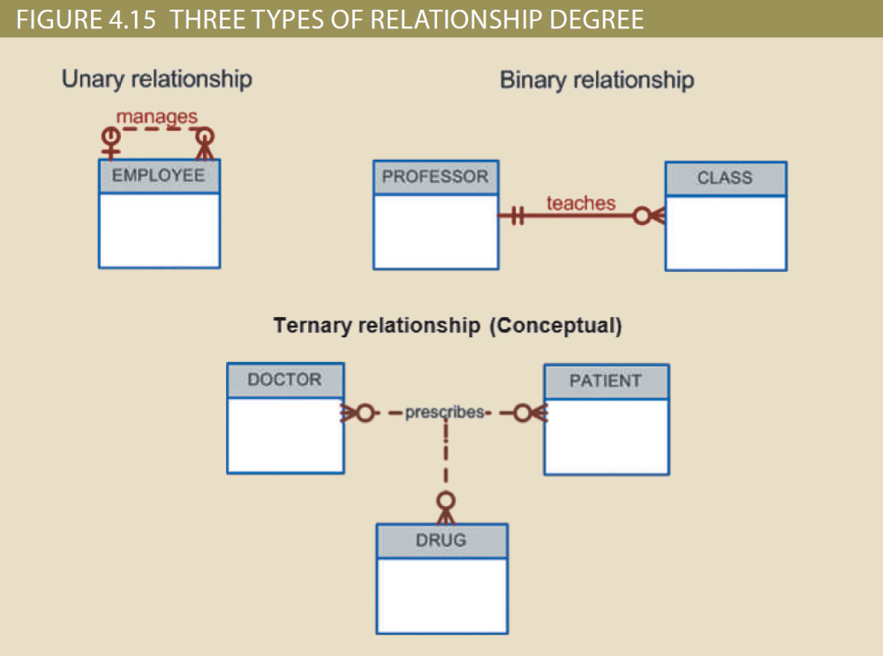
E-R Model
Degree of Relationship

Slide 24
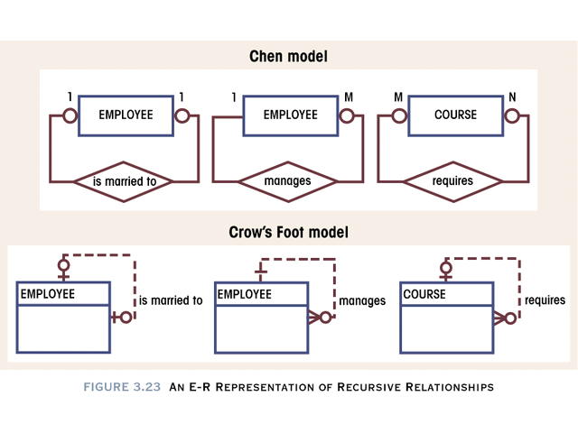
E-R Model
Recursive or Unary Relationship

Slide 25
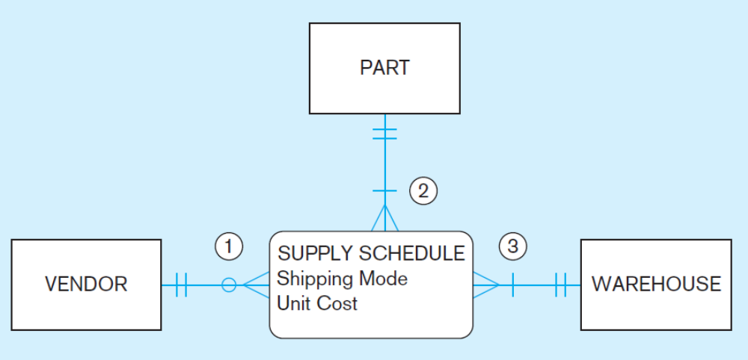
E-R Model
Ternary Relationship

Slide 26
Associative Entity
Like entities, relationships can also have one or more attributes.
An attribute whose value is jointly determined by the participants is an attribute of a relationship. Example …..
An associative entity is a many to many relationship that is represented as an entity type.
It is also called an entity in disguise or a Composite or Bridge Entity.
Associative entity is an entity derived from a relationship.
It is represented by and Enclosed diamond symbol within entity box
Example 1 (next slide)
Example 2 (Shipment: A ternary relationship among Product, Vendor, Warehouse)
Notes:
Attributes of a Relationship
Fig. 2-11 Page 79 (J. Hoffer 10th Ed.)
An attribute cannot be associated with a one-to-many relationship

Slide 27
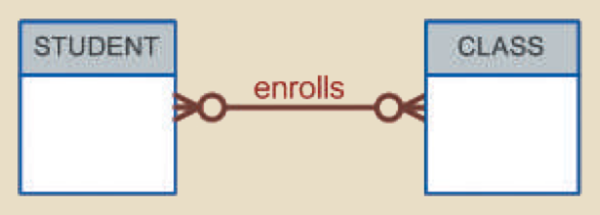
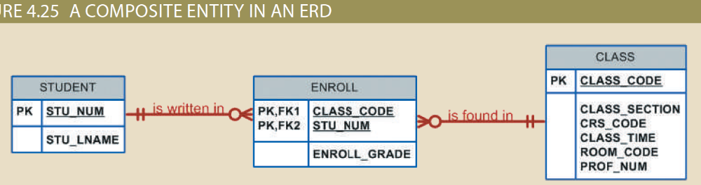
Associative Entity

Slide 28
Gerund – Example
Certificate_Number
Date_Completed
Course_ID
Emploee_ID
Employee_Name
EMPLOYEE
CERTIFICATE
COURSE
Course_Title
Topic
Birth_Date
Associative Entity

Slide 29
Converting Relationship to an Associative Entity
Conditions are:
  All of the relationships for the participating entity types are “many” relationships
  The resulting associative entity has independent meaning to end users, & preferably can be identified with a single-attribute identifier
  The associative entity has one or more attributes in addition to the identifier
  The associative entity participates in one or more relationships independent of the entities related in associated relationship

Slide 30
E-R Model
Modeling Multivalued Attributes
A multivalued attribute of an entity is converted to a separate entity that has a relationship to the entity type from which it was removed.
Examples:
Emp (empno, ename, job, …, skills*)
Student (Regno, sname, …, courses*)
The idea behind introducing the new entity is that the new entity is of independent interest to the organization, rather than just an attribute of other entity types.

Slide 31
E-R Model
Modeling Repeating Groups
A repeating group is a set of two or more multivalued attributes that are logically related.
Repeating groups are handled in the same way as a multivalued attribute.
Examples
Emp (empno, ename, job, …, skill#*, skill-name*, s-level*)
Student (Regno, sname, …, c-code*, c-title*, c-grade*)

Slide 32
Modeling Time Dependent Data
A time dependent data is a data whose values change over time.
For Example: Price of a Product
Product (P#, P-name, …, price)
Product (P#, P-name, …, price*, eff-date*)
Each value of the attribute price is time stamped with its effective data.
A Time Stamp is a time value associated with any data value.
A time stamp is used when we need to maintain a history of data values that change over time.
Notes:
Attributes of a Relationship
Fig. 2-11 Page 79 (J. Hoffer 10th Ed.)
An attribute cannot be associated with a one-to-many relationship

Slide 33
Extended or Enhanced ER Model
The model that has resulted from extending the original E-R model with new modeling constructs.
Used to cope with the dynamic and complex business environment.
It uses the representations for supertypes and subtypes.

Slide 34
E-R Model
Super Types, Subtypes - Example
EMPLOYEE TYPE | ATTRIBUTES
1. Hourly | ENo, EName, Address, Hire_Date, Hourly_Rate
2. Salaried | ENo, EName, Address, Hire_Date, Salary
3. Contract | ENo, EName, Address, Hire_Date, Rate
We have three choices for ER diagram:
Define a single entity type Employee with all the possible attributes in it.
Define a separate entity type for each employee type.
Define a supertype with all the common attributes and introduce its subtypes having only the applicable attributes.
ER Diagram

Slide 35
E-R Model
Super Types, Subtypes
A Super type is a generic entity type that is subdivided into subtypes.
A Subtype is a subset of a super type that shares the common attributes of the super type plus it has some of its own attributes that distinguish it from other subtypes.
The super type and subtypes employ the concept of Generalization and Categorization.
Generalization is the concept that some entities are subtypes of other more general entities. E.g. Bird, Vehicle etc.
Categorization is the concept that an entity comes in various subtypes.
Super type & Subtype representation is used to represent the entities that are very much similar.
Attribute Inheritance:
  Subtype entities inherit values of all attributes of the supertype
  Subtype entities inherit their primary key from their supertype
  An instance of a subtype is also an instance of the supertype

Slide 36
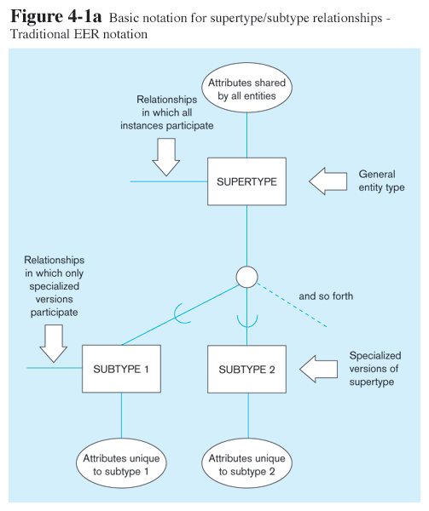

Slide 37
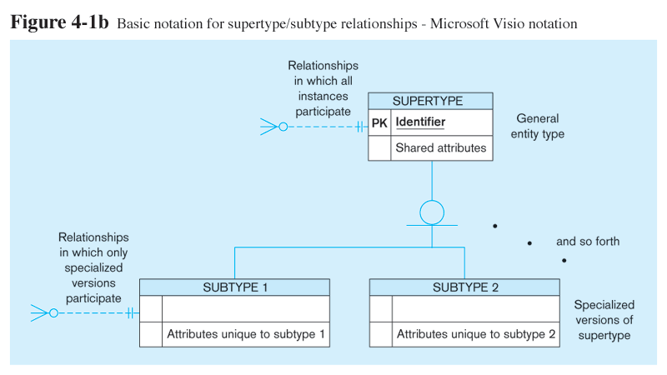
Basic Notations for Super Type/Subtype
Different modeling tools may have different notation for the same modeling constructs

Slide 38
E-R Model
Super Types, Subtypes - Example
EMPLOYEE TYPE | ATTRIBUTES
1. Hourly | ENo, EName, Address, Hire_Date, Hourly_Rate
2. Salaried | ENo, EName, Address, Hire_Date, Salary
3. Contract | ENo, EName, Address, Hire_Date, Rate
We have three choices for ER diagram:
Define a single entity type Employee with all the possible attributes in it.
Define a separate entity type for each employee type.
Define a supertype with all the common attributes and introduce its subtypes having only the applicable attributes.
ER Diagram

Slide 39
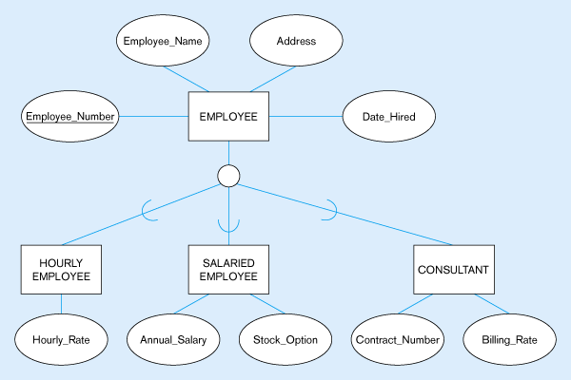
Figure 4-2 – Employee supertype with three subtypes
All employee subtypes will have emp nbr, name, address, and date-hired
Each employee subtype will also have its own attributes

Slide 40
E-R Model
Super Types, Subtypes
The relationship between each subtype and its super type is called ISA relationship.
The relationship is read from the subtype to the super type.
The cardinality of the relationship from subtype to super type is always mandatory one and from super type to subtype is optionally one. Henceforth, cardinality may be omitted in diagram.

Slide 41
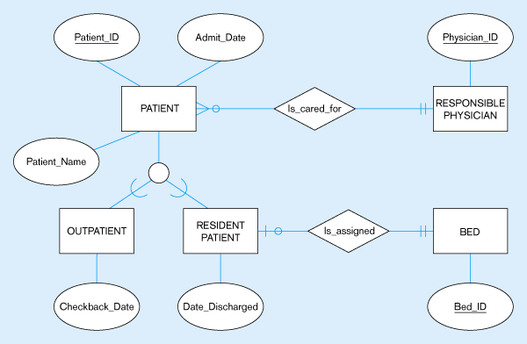
Supertype/subtype relationships in a hospital
Both outpatients and resident patients are cared for by a responsible physician
Only resident patients are assigned to a bed

Slide 42
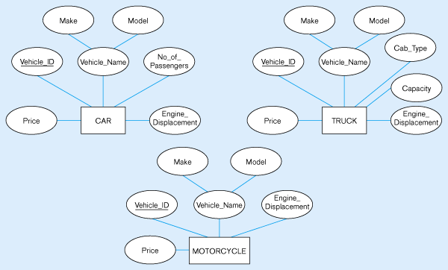
Example of generalization
Three entity types: CAR, TRUCK, and MOTORCYCLE
All these types of vehicles have common attributes

Slide 43
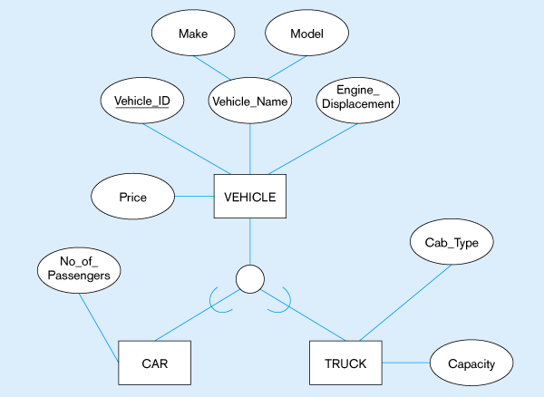
Generalization to VEHICLE supertype
So we put the shared attributes in a supertype
Note: no subtype for motorcycle, since it has no unique attributes

Slide 44
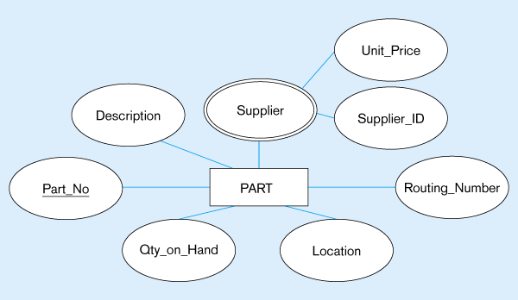
Example of specialization
Entity type PART
Applies only to purchased parts
Only applies to manufactured parts

Slide 45
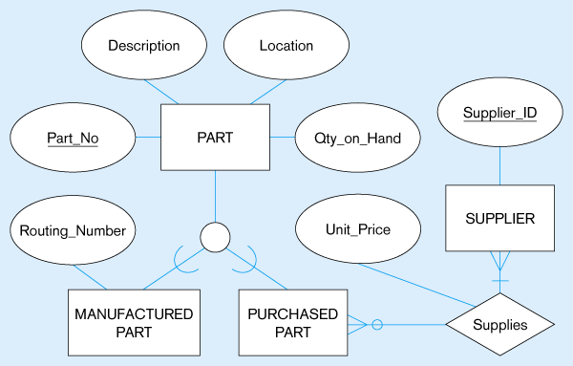
Specialization to MANUFACTURED PART and PURCHASED PART
Created 2 subtypes
Note: multivalued attribute was replaced by a relationship to another entity

Slide 46
E-R Model
Types of Subtypes
There are the following types of subtypes:
Exhaustive & Non-Exhaustive subtypes (Completeness Constraint)
Exclusive & Non-Exclusive subtypes.
Exhaustive subtypes mean that all the subtypes have been defined and there can’t be any further subtypes.
Exclusive subtypes mean that each instance of a super type is categorized as exactly one subtype.

Slide 47
E-R Model
Types of Subtypes
a) Exhaustive & Non-Exhaustive subtypes
Exhaustive subtypes mean that all the subtypes have been defined and there can’t be any further subtypes.
It is used for enforcing completeness constraint, which determines, Whether an instance of a super type must also be a member of at least one subtype
  Total Specialization Rule: Yes (double line)
  Partial Specialization Rule: No (single line)

Slide 48
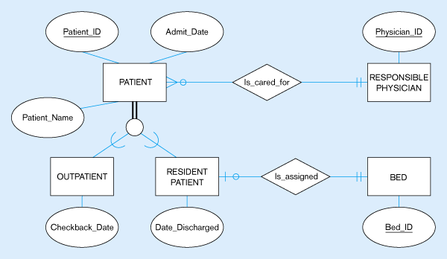
Total Specialization Rule
A patient must be either an outpatient or a resident patient

Slide 49
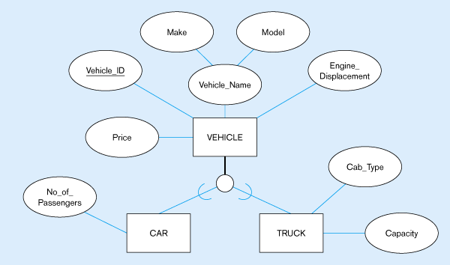
Partial Specialization Rule
A vehicle could be a car, a truck, or neither

Slide 50
E-R Model
Types of Subtypes
b) Exclusive & Non-Exclusive subtypes
Exclusive subtypes mean that each instance of a super type is categorized as exactly one subtype.
It is used for enforcing Disjointness Constraints, which determines, Whether an instance of a super type may simultaneously be a member of two (or more) subtypes
  Disjoint Rule: An instance of the super type can be only ONE of the subtypes
  Overlap Rule: An instance of the super type could be more than one of the subtypes

Slide 51
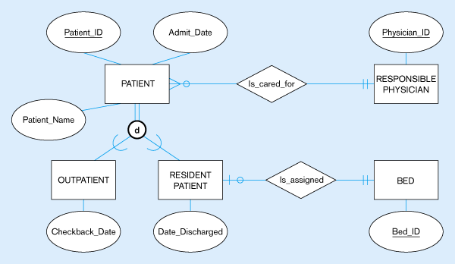
Disjoint Rule
A patient can either be outpatient or resident, but not both

Slide 52
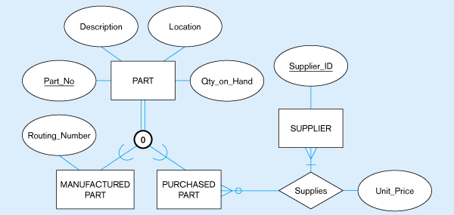
Overlap Rule
A part may be both purchased and manufactured

Slide 53
Subtype Discriminators
An attribute of the super type whose values determine the target subtype(s)
  Disjoint – a simple attribute with alternative values to indicate the possible subtypes
  Overlapping – a composite attribute whose subparts pertain to different subtypes. Each subpart contains a Boolean value to indicate whether or not the instance belongs to the associated subtype

Slide 54
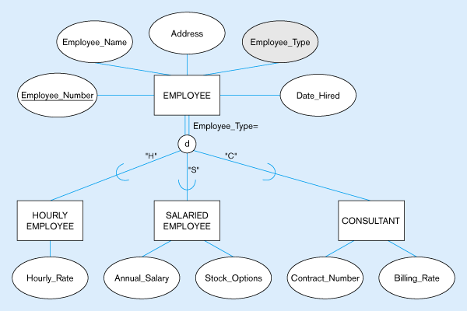
Subtype Discriminator (disjoint Rule)
A simple attribute with different possible values indicating the subtype

Slide 55
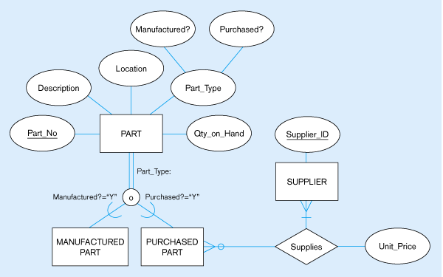
Subtype discriminator (Overlap Rule)
A composite attribute with sub-attributes indicating “yes” or “no” to determine whether it is of each subtype

Slide 56
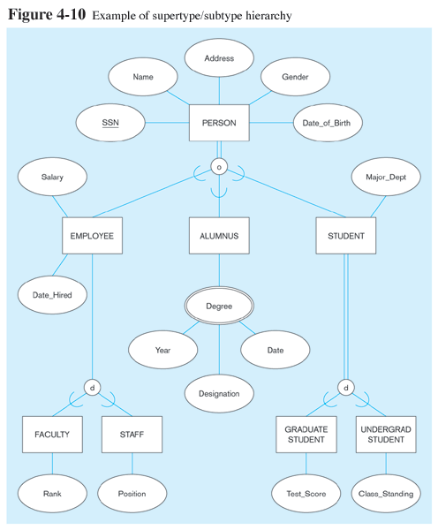

Slide 57
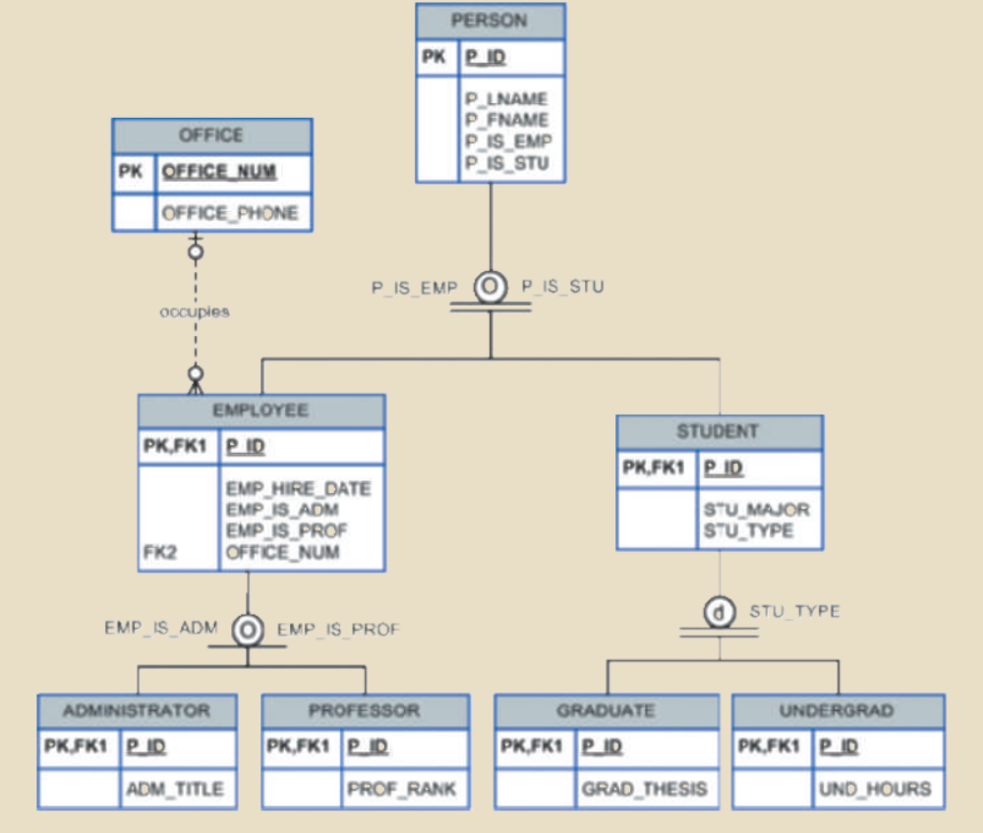

Slide 58
Entity Clustering
Entity clustering is a useful way to present a data model a large and complex systems involving hundreds of entities.
An entity cluster is a virtual entity type formed by combining multiple related entities.
Referring to the examples discussed, the entities related employee, patient, part can be clustered together.
The cardinalities of the relationships of the clustered entities with the other entities remain the same.

Slide 59
Reading Material
Book | Chapter | Sections / Pages
Text Book | 4, 5 | Sections 4.1, 4.2, 5.1
Ref. Book A | 2 | Pages 57-94, 113-126
Ref. Book B | 12 | Sections 12.1 to 12.3

Slide 60
Thank you for your attention.
Asif Sohail
Assistant Professor
University of the Punjab
Punjab University College of Information Technology (PUCIT)
Allama Iqbal (Old) Campus, Anarkali
Lahore, Pakistan
Tel: +92-(0)42-111-923-923 Ext. 154
E-mail: asif@pucit.edu.pk

